Slide 1






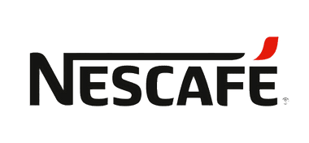
Title:- “Nescafe Shoppers: A Comparative Analysis With Starbucks”
Presented By:- Rajkumar Solanki

Slide 2
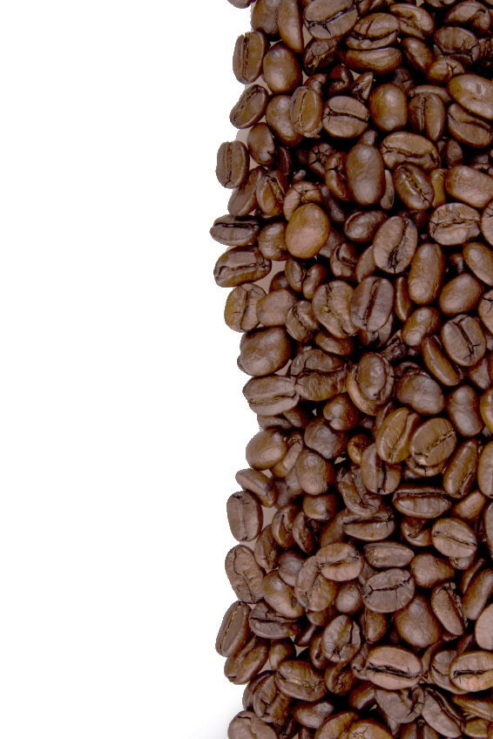


TABLE OF CONTENTS
01
INTRODUCTION
06
COMPARISON B/W NESCAFE AND STARBUCKS
Overview of the Dataset
How Nescafe different from Starbucks
02
NESCAFE SHOPPERS
07
CONCLUSION
Who are the shoppers of Nescafe?
Summary of insights
03
STARBUCKS SHOPPERS
08
SUGGESTION FOR NESCAFE
Who are the shoppers of Starbucks?
Strategies that Nescafe implement to attract Starbucks shoppers
04
Nescafe Shoppers' Preferences
What shoppers like about Nescafe?
05
Starbucks Shoppers' Preferences
What shoppers like about Starbucks?

Slide 3




INTRODUCTION
This presentation provides an in-depth analysis of Nescafe shoppers and their market behavior, alongside a comparison with Starbucks shoppers. The objective is to explore how consumers engage with each brand's products and services, identifying key characteristics that differentiate Nescafe from Starbucks shoppers.
The dataset used for this analysis includes a variety of important features such as:
Demographics: Age, gender, and income groups
Population Characteristics: Shopper behavior patterns
Shopper Distribution: % of Nescafe Shoppers, % of Starbucks Shoppers
Index Values: Relative performance of each demographic in comparison to the average population
Through the use of charts, graphs, and advanced Excel tools like pivot tables, this analysis uncovers valuable insights that will help Nescafe better understand their current consumers and explore strategies to attract Starbucks shoppers.

Slide 4

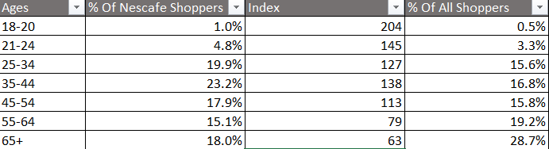
“Who Are Nescafe Shoppers?”
Age Group Breakdown for Nescafe Buyers:
18-20 Years: 1% of buyers from this group make up Nescafe's total shoppers, and its index of 204 shows that it is overrepresented. This indicates that Nescafe has a niche presence among this age group.
21-24 Years: 4.8% of buyers from this age group are Nescafe shoppers, with an index of 145. This indicates that they are more likely to choose Nescafe compared to the general population, highlighting strong engagement with younger adults.“
25-34 : 19.9% of buyers in this group are Nescafe shoppers, and their index of 127 reflects that they are slightly overrepresented. This makes this age range a key target demographic for Nescafe, showing steady brand loyalty.
5. 45-54 : 17.9% of buyers in this group are Nescafe shoppers, with an index of 113. This age group is slightly overrepresented, showing that Nescafe maintains strong appeal among middle-aged adults.
6. 55-64 : 15.1% of buyers are Nescafe shoppers in this group, but with an index of 79, they are underrepresented. This suggests that Nescafe has less penetration in this older age range, presenting a possible area for improvement
7. 65 + : 18% of buyers are from this age group, but an index of 63 indicates they are significantly underrepresented. Nescafe could benefit from further engagement with older shoppers to capture more of this market.

Slide 5
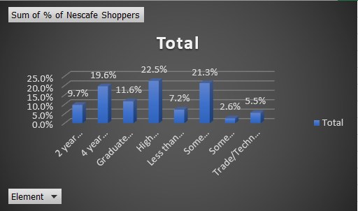
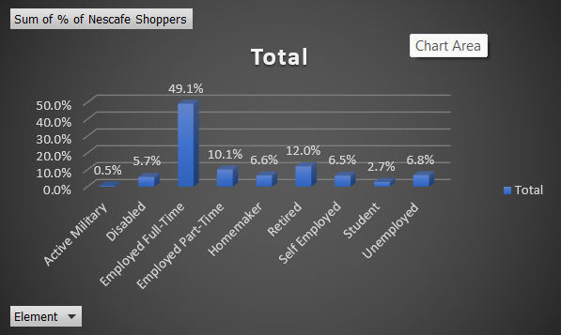
“Who Are Nescafe Shoppers?”
Buyers from Different Education level:-
Buyers from Different Employment level:-
High School/GED and those with less than a high school education make up a significant portion of Nescafe's customer base.
Graduate Degree: 11.6% of Nescafe shoppers, with an index of 75, indicating less engagement from this group.
4-Year College Degree and Graduate Degree holders are underrepresented, indicating less interest in Nescafe from these groups.
Employed Full-Time shoppers are the largest group, making up 49.1% of Nescafe shoppers, indicating strong engagement from full-time workers.
Retired individuals make up 12%, showing Nescafe's appeal to older
Students make up 2.7%, and Active Military represents the smallest group at 0.5%.

Slide 6

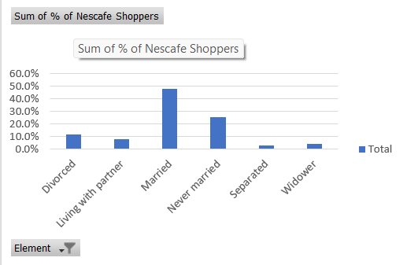
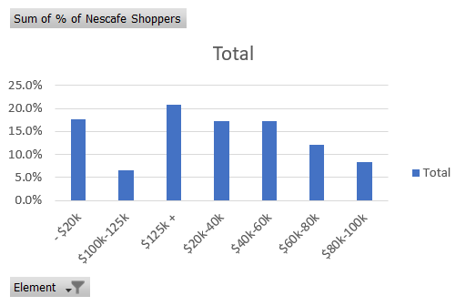
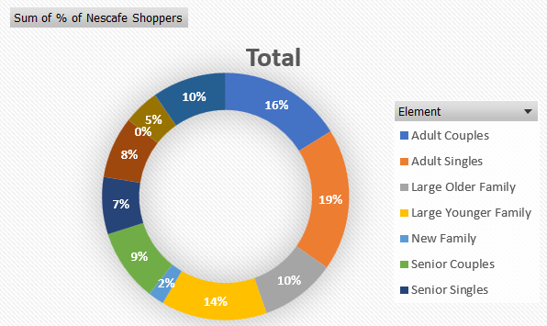

Nescafe Buyers By there Marital status
Nescafe Buyers By there Income
Nescafe Buyers By there Lifestages

Slide 7

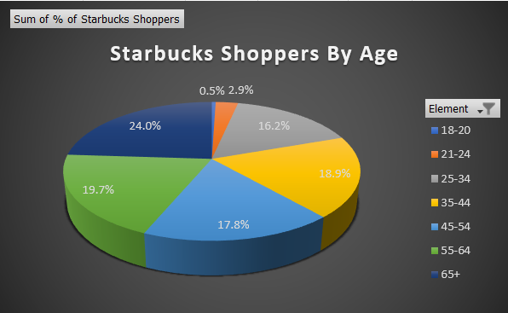
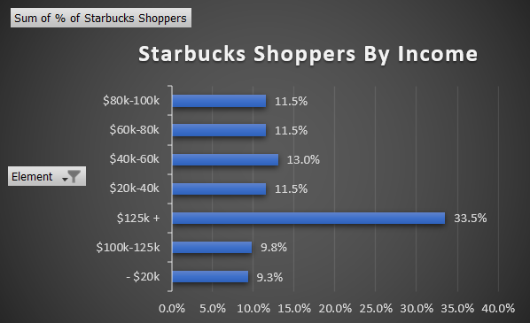
“Who Are Starbucks Shoppers?”
When we talk about Starbucks users by age, the 65+ age group represents the largest segment of Starbucks shoppers with 24%, while the 35-44 age group has a balanced representation with 18.9%. The 18-20 age group has the lowest portion of users.
$125k+ income group represents the largest portion of shoppers at 33.5%
Income groups $20k-40k, $60k-80k, and $80k-100k each make up 11.5% of the customer base
The $20k or less income group represents the smallest segment at 9.3%.

Slide 8


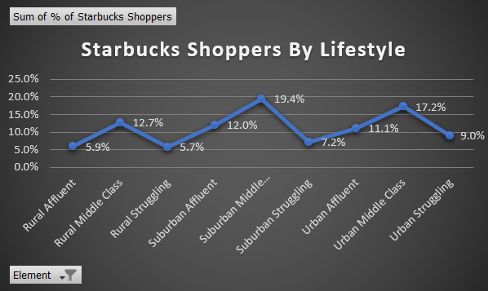
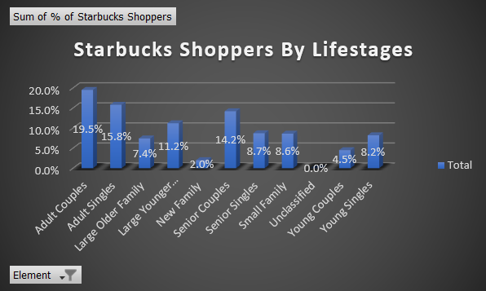

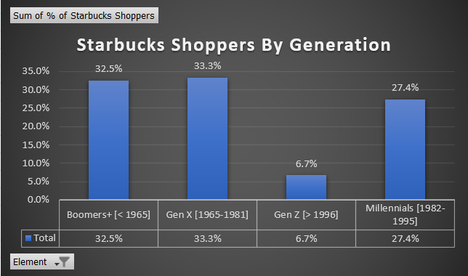
“Who Are Starbucks Shoppers?”
Nescafe's largest shopper base comes from the Suburban Middle Class (19.4%) and Urban Middle Class (17.2%)
Suburban Affluent and Urban Affluent shoppers represent 12.0% and 11.1%
Rural Affluent (5.9%) and Rural Struggling (5.7%) segments, indicating minimal engagement from rural areas overall
The largest portion of Nescafe's customers comes from Adult Couples (19.5%) and Adult Singles (15.8%). The smallest customer base is from New Families (2.0%) and Young Couples (4.5%)
The largest portion of Nescafe's customers comes from Gen X (33.3%) and Boomers+ (32.5%)
smallest segment is Gen Z (6.7%). Millennials make up a significant share at 27.4%.

Slide 9



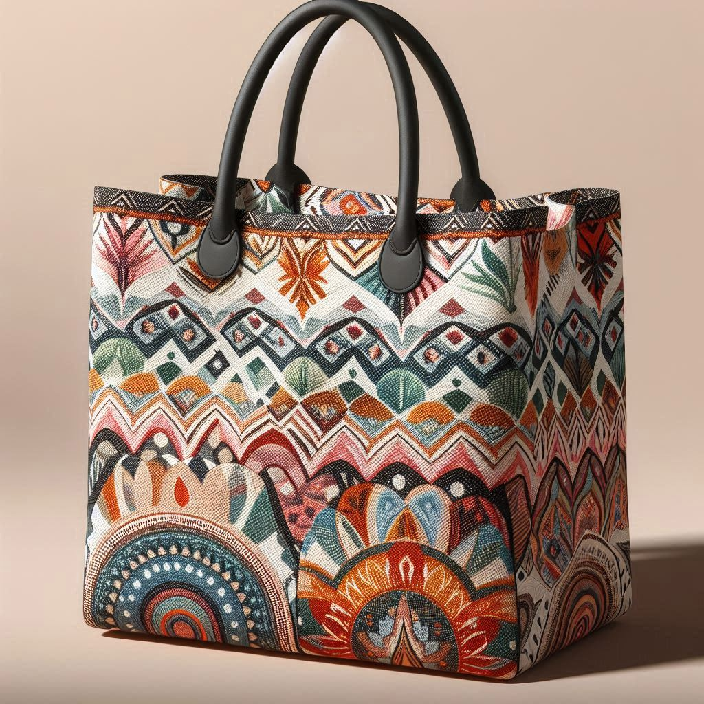

“Nescafe Shoppers Preferences”
We can divide Nescafe shoppers Preferences into 6 Category :-
Consumer's Preference
Advertising
Eating
Health & Sustainability
Sports Fandom
Shopping
Interests

Slide 10




ADVERTISING
How people search for Products and Services
Most Influential Touchpoints
In-Store: 51.4% learn about products and brands directly from in-store experiences
Print Media: 43.7% rely on print media to discover products and services
Outdoor Advertising: 27.5% gain awareness through outdoor advertising like billboard
Social Media: 17.4% learn via social media platforms
Promotional Emails/Texts: 15.0% discover products through promotional messages
Social Media: 20.1% find social media to be the most influential platform
Online Mobile Devices: 16.0% view mobile devices as highly influential
Outdoor Advertising: 4.6% are influenced by outdoor advertising.
In-Store: 2.5% consider in-store interactions to be influential
Radio: 1.0% consider radio to be an influential source

Slide 11

Nescafe shoppers Preferences By:-
Eating
Health & Sustainability
Shopping
The majority of households, 70.6%, report having no special dietary requirements, indicating a large general consumer base without restrictions
Lactose-free is the most common dietary requirement, with 12.6% of households affected, followed by Gluten-free at 7.8%
Vegan (4.8%), Pescatarian (4.2%), and various forms of Vegetarian (ranging from 2.8% to 3.6%) make up smaller but notable portions of consumers
Grain-free diets are the least common, affecting 3.2% of households
Health Management:
Active Participants: A combined 50.3% of respondents are very active (23.3%) or active (27.0%) in managing their health
Less Active Participants: 18.4% are slightly active (10.8%) or not at all active (7.6%)
Health Habits:
A significant portion, 36.2%, takes vitamins or supplements.
21.7% prioritize family needs over their own health
Many shoppers prefer popular brands (40.3%) and rarely consider private label (PL) options (9.8%). However, 36.4% believe PL quality has improved, and 24.6% feel they are just as good. Shoppers buy PL to save money (25.3%) and choose based on price (25.7%)
37.9% are values-driven, and 34.9% are status-driven. A lot of shoppers enjoy trying new things (52.1%) and clipping coupons (32.8%), but only 8.7% like quick shopping trips. Online shopping is generally viewed positively, with 31.8% finding it very enjoyable and 32.2% finding it enjoyable. However, 56.5% think online deals aren’t great, and 38.0% prefer shopping in stores.

Slide 12
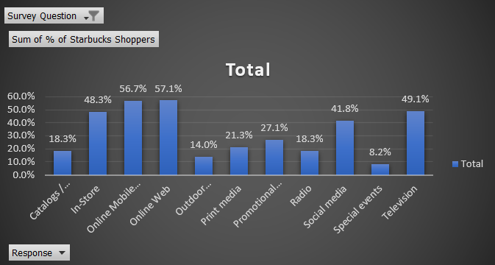



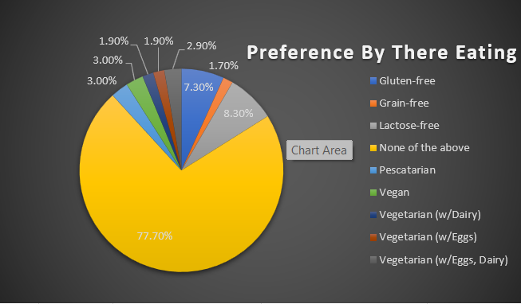

“Starbucks Shoppers Preferences”
From where they now about Products and Services
77.7%, have no specific dietary preferences. The next most common preference is for lactose-free diets at 8.3%, followed by gluten-free at 7.3%

Slide 13
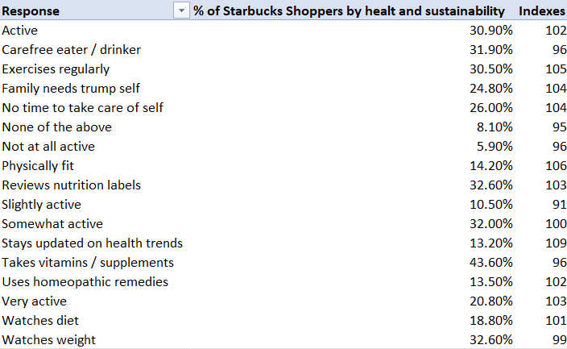
“Starbucks Shoppers Preferences”
Consumer Preferences by Health and Sustainability :-
43.6% of Starbucks shoppers take vitamins/supplements, showing a strong commitment to health maintenance.
32.6% are conscious about their weight, regularly watching their weight and reviewing nutrition labels.
30.9% are active in managing their health, while 20.8% are very active
Only 5.9% are not at all active in managing their health, suggesting most customers are at least somewhat health-conscious
When we talk about Index:-
Physically fit shoppers have the highest index at 106
Family needs trump self and no time to take care of self have indexes of 104
Taking vitamins/supplements has an index of 96

Slide 14




“Starbucks Shoppers Preferences”
45.1% Shoppers
38.7% Shoppers
63.6% Shoppers
58.6% Shoppers
63.6% of consumers feel online shopping saves them time
45.1% of Consumers Activity is Listening to music
58.6% of shoppers are list-makers
38.7% have a passion for cooking

Slide 15
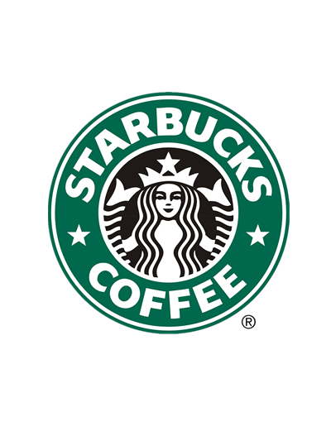

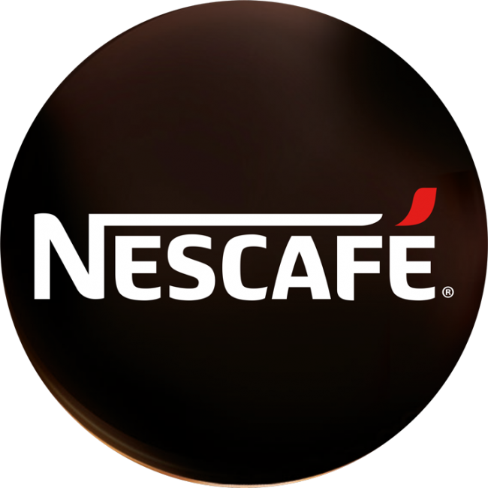
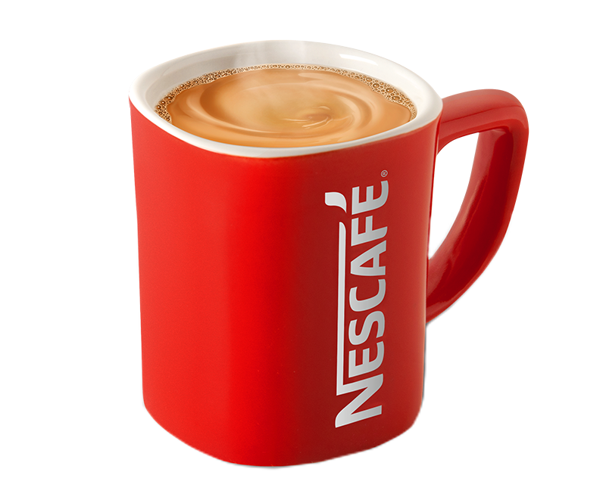
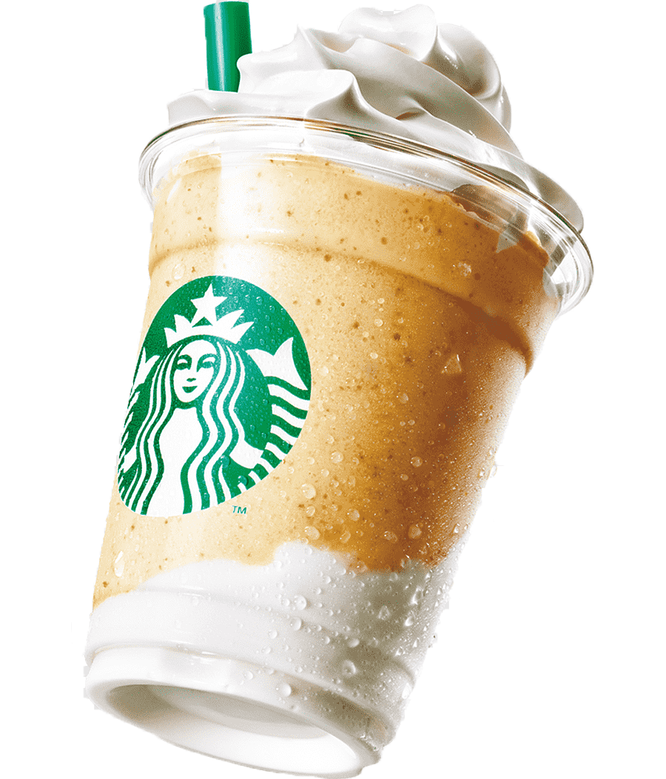
How do Nescafe shoppers differ from Starbucks shoppers?
Nescafe Shoppers
Starbucks Shoppers
VS

Slide 16

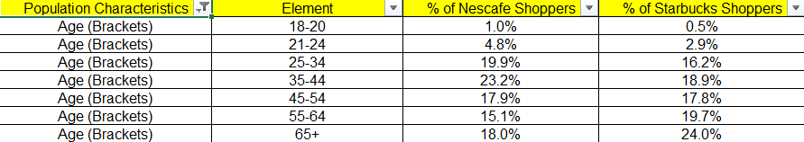

Difference between Nescafe and Starbucks based on Shopper Characteristics
By age group:-
"We can see from the chart that Nescafe has more younger shoppers compared to Starbucks. For example, in the 18-20 age group, Nescafe has 1% while Starbucks has 0.5%. In the 25-34 age group, Nescafe has 19.9% and Starbucks has 16.2%. However, Starbucks attracts more older shoppers, particularly those aged 55 and above. For instance, in the 55-64 age group, Nescafe has 15.1% of shoppers, while Starbucks has 19.7%."

Slide 17
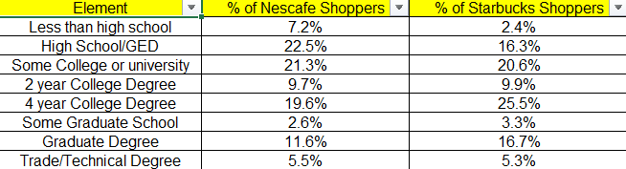
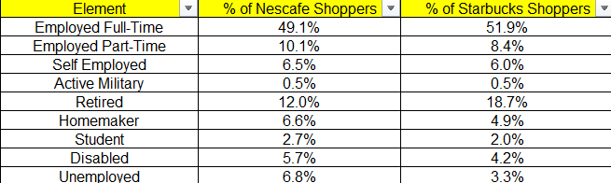

By Education Level:-
Nescafe shoppers generally have lower education levels than Starbucks shoppers For example, 7.2% of Nescafe shoppers have less than a high school education, while only 2.4% of Starbucks shoppers fall into this category
By Employment:-
A higher percentage of Nescafe shoppers are employed full-time compared to Starbucks shoppers
Starbucks shoppers have a higher rate of retirement 18.7% compared to Nescafe shoppers 12.0%

Slide 18

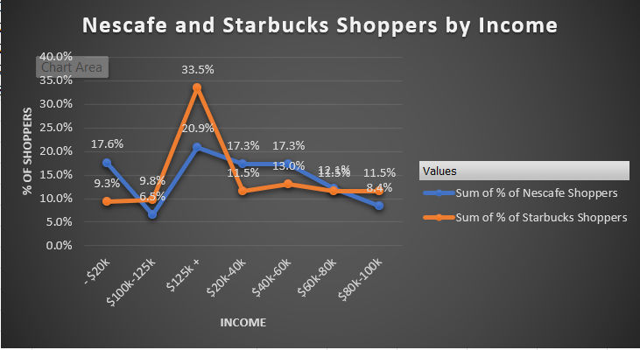
Shoppers by their Income
A higher percentage of Nescafe shoppers earn less than $20k 17.6% compared to Starbucks shoppers 9.3%
Nescafe shoppers show a significant percentage 20.9% in the $125k and above income bracket, while Starbucks shoppers lead in this category with 33.5%
For the $20k - $40k and $40k - $60k income brackets, Nescafe and Starbucks shoppers have similar percentages

Slide 19

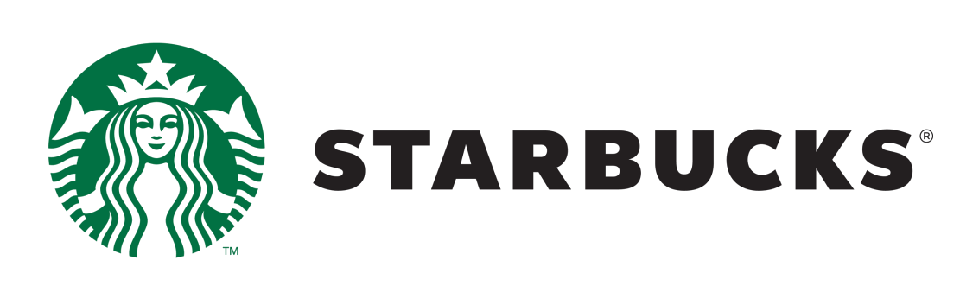

Difference between Nescafe and Starbucks based on Shopper Preferences
"After analyzing the data on consumer preferences, we find that Starbucks shoppers are more likely to use online platforms, especially mobile devices and social media, to learn about products"
"Nescafe shoppers tend to rely more on traditional methods like television, print media, and radio"

Slide 20

CONCLUSION:-
How Nescafe can attract/capture Starbucks shoppers?

Slide 21


How Nescafe can attract/capture Starbucks shoppers:-
1
2
Strategies for Nescafe to attract and capture Starbucks shoppers across different age groups, particularly focusing on the younger audience (18-24 years) and addressing the gaps in the older audience (55+ years)
Target Full-Time Employed Shoppers
Engage Retired Consumers
Appeal to Unemployed Shoppers
3
Offer affordable pricing and bundle deals to appeal to those earning less than $20k Appeal to Unemployed Shoppers
4
Develop and market premium coffee products that can compete with Starbucks' offerings

Slide 22














How Nescafe can attract/capture Starbucks shoppers:-
Based on the dataset, it was found that most of the Starbucks shoppers come from online sources, such as mobile or the internet, while Nescafe shoppers primarily come from traditional sources like TV, radio, articles, and newspapers. To attract Starbucks shoppers, Nescafe needs to enhance its presence in online sources as well
Organize networking events where job seekers can gather over coffee
Consider promotional campaigns specifically aimed at unemployed consumers, such as discounts or giveaways, encouraging them to enjoy Nescafe as they navigate their job search

Slide 23
Thank You

